Slide 1
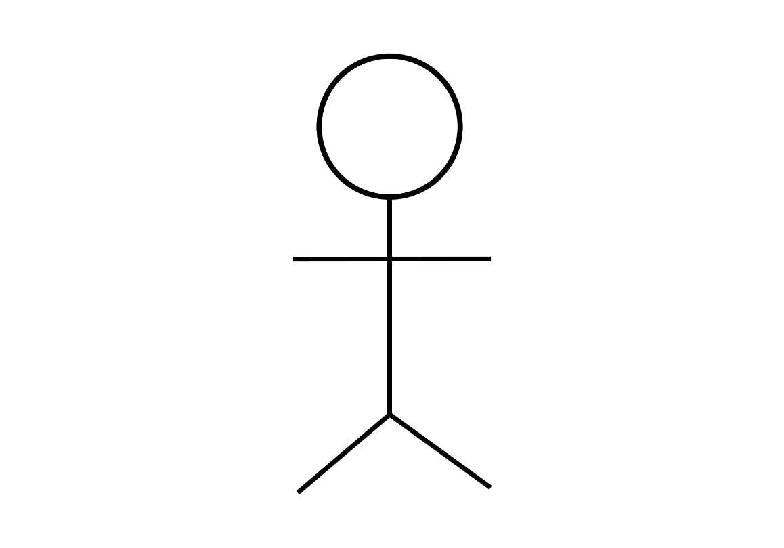
1st Module User Account Management
Register Details
<<extend>>
Perform Login
View Account Details
Staff
<<extend>>
Edit Account Details
End User
Add New Staff Account
Remove Staff Account
<<extend>>
View Staff Account
Admin

Slide 2
2nd Module Products (Cloths)
View products with search filters
Add products
Edit products information
<<extend>>
View existing products
End User
<<extend>>
Admin / Staff
Delete products
Restock products
<<extend>>
View available stocks

Slide 3
3rd Module Purchase
Add item to cart
Edit quantity or size in cart
<<extend>>
View cart items
<<extend>>
Remove item from cart
Make payment
End User
View purchase history
Admin / Staff
Manage orders from customers
View sales history

Slide 4
4th Module Report
View sales using graphs
<<extend>>
Print graphs
View overall profit
Admin / Staff
<<extend>>
Print overall profit

Slide 5
5th Module Contact and Review
Provide review and rating
View review and rating by other users
Receive review and ratings
<<extend>>
End User
Manage review and ratings
Admin / Staff
Live chat

